Slide 1
Evaluating the MD-GAN architecture for distributed training of Generative Adversarial Networks Omid Davoudi (omiddavoudi@cmail.Carleton.ca) COMP 5704 – Frank Dehne – Dec. 2019 School of Computer Science, Carleton University, Ottawa, Canada
Determining the susceptibility of MD-GAN networks to nodes containing datasets with different class distributions

Slide 2
Table of Content
Introduction
What are Generative Adversarial Networks
GANs – An Analogy
Distributed Machine Learning
MD-GAN
Potential vulnerability of MD-GAN
Testing and Results
Conclusion and Future work

Slide 3
Introduction
Machine Learning has seen a boom in recent years
Big Data increases the need for distributed Machine Learning
Regulations might prevent movement of data between countries
Some algorithms are harder to distribute

Slide 4
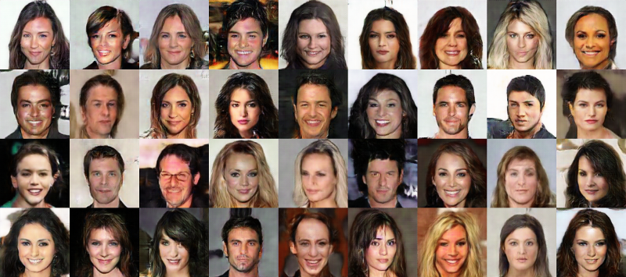
What are Generative Adversarial Networks
A neural network architecture designed for generating new data
New data follows the same rules as the input dataset
A number of faces generated by a GAN. Image from www.freecodecamp.org

Slide 5
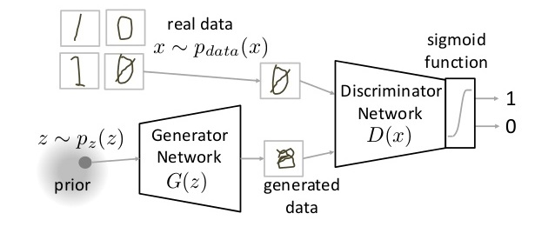
What are Generative Adversarial Networks
GANs consist of two separate networks. The Generator and the Discriminator.
Generator gets a randomly generated latent vector and outputs the new data.
Discriminator gets a data point and determines whether it is real (from the dataset) or fake (created by the generator).
These two networks are trained together so that they can learn from each other.
Image from lanpartis.github.io

Slide 6
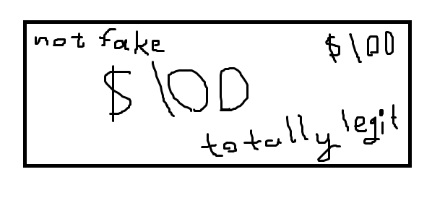
GANs – An Analogy
Suppose we have a novice police, a novice money counterfeiter and a corrupt police in league with the money launderers.
At first the money counterfeiter tries his hand in creating fake money

Slide 7
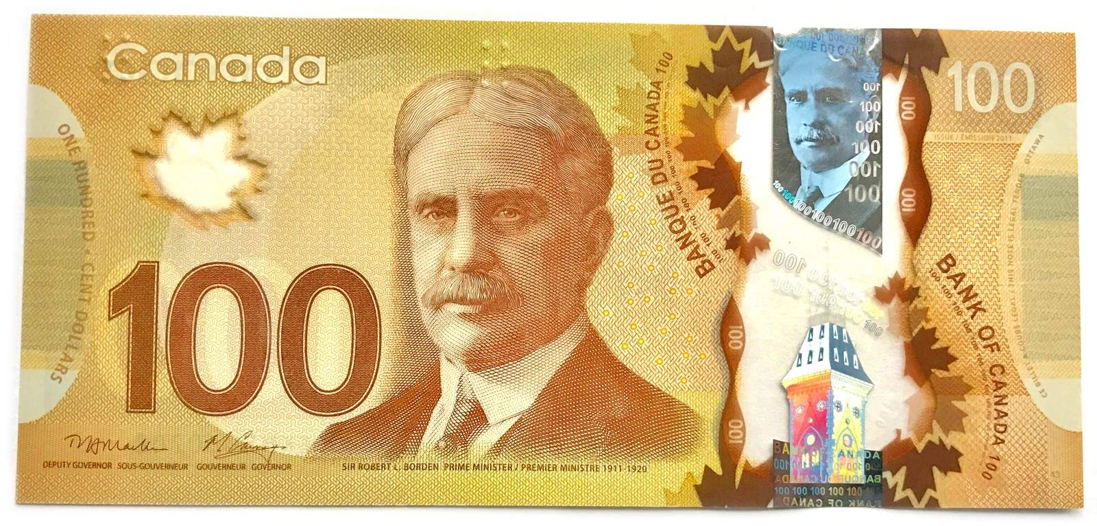
GANs – An Analogy
Now this fake bills finds its way into the hand of the police. The novice police officer sees this and says: “Oh. It says legit. So it is legit then”.
His colleagues see this and say, wow, look at some real banknotes. This is totally fake.
He sees a real banknote and see that “Oh! Real banknotes have a portrait on them!” and starts to detect the fake money.

Slide 8
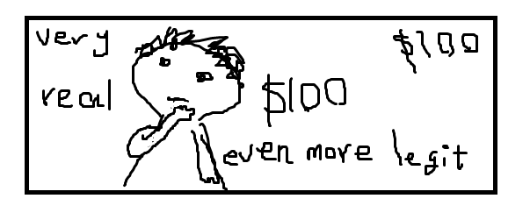
GANs – An Analogy
The money counterfeiter notices that his fake money is being detected. So he calls the corrupt officer and finds out that the police is detecting his bills because they don’t have a portrait.
So, he decides to add a portrait. And this fools the police for a while.

Slide 9
GANs- An Analogy
This process goes on until the counterfeiter is able to create fake money that is much closer to the real money than his first attempts. The police officer will in turn become an expert in detecting them.
In this situation, the generator is the counterfeiter, the police officer is the discriminator and the corrupt policeman is the gradients that are propagated from the discriminator to the generator.
Note that there is no guarantee that this process converges. Training is notoriously difficult.
Notes:
Even if it converges, It might converge to a suboptimal point where there are noticeable defects in the outputs of the generator but the discriminator is not able to overcome them.
Even if it converges, It might converge to a suboptimal point where there are noticeable defects in the outputs of the generator but the discriminator is not able to overcome them.

Slide 10
Distributed Machine Learning
Two categories:
General Distributed Machine Learning – No dependence on algorithm itself. Not very capable either.
Case Specific Distributed Machine Learning – Better results than the previous one, but only works for specific algorithms.
In our case, there are methods for distributed training of Neural Networks, and an even more specific method for the distributed training of GANs themselves.

Slide 11
MD-GAN
Instead of using one Discriminator, use many of them. One for each node in the cluster.
The generator resides in the main server. Each node calculates the gradient update for the generator and sends them to the server for final training.
Each discriminator is trained on the local dataset.
After a number of episodes, the discriminators are shuffled so that they do not overfit on the local data

Slide 12
Potential vulnerability of MD-GAN
What happens when the class distributions in the datasets are different?
GANs easily fall apart during training. Could this result in a non-convergence?
Specifically, the discriminators might detect underrepresented classes in their own local dataset as fake. This might in turn, prevent the generator from learning anything

Slide 13
Testing and Results
Test setup: 4 nodes. One of them is the main node containing the generator, the other 3 are workers containing their own respective discriminator. Base GAN model was a simple DCGAN.
Each node has 4 CPUs. Training done using pytorch.
5 different cases of class distribution skew. 0%, 20%, 40%, 60%, 80% and 100%.
Dataset is MNIST handwritten digits. Itself is about 5% skewed.
Dataset is broken into chunks and given to each node.

Slide 14
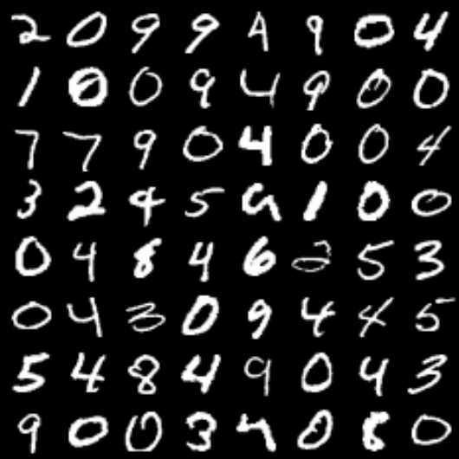
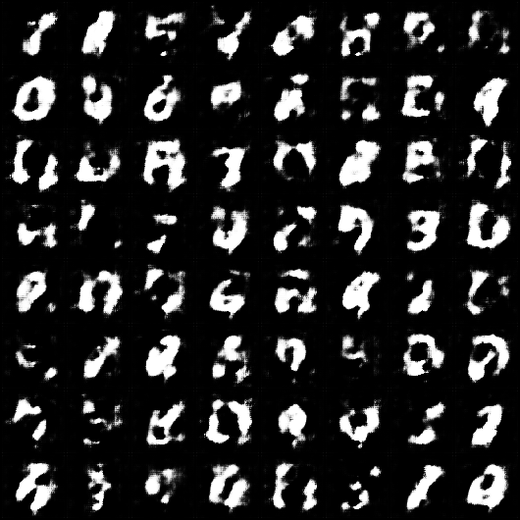
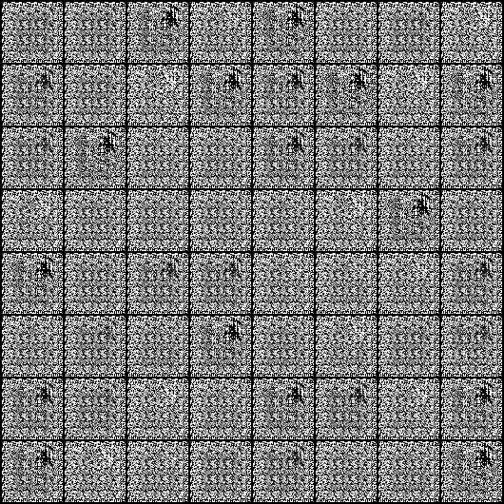
Testing and Results
Base GAN implementation not very robust. Only able to reach very limited results before deteriorating beyond recovery.

Slide 15
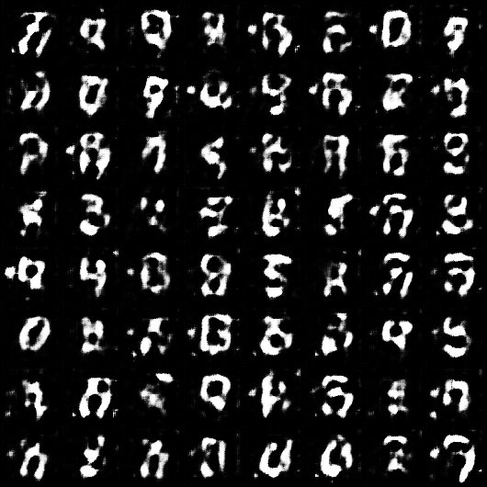
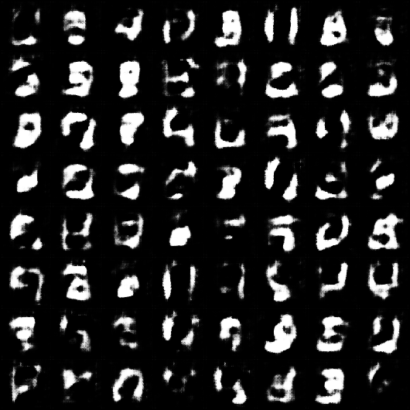
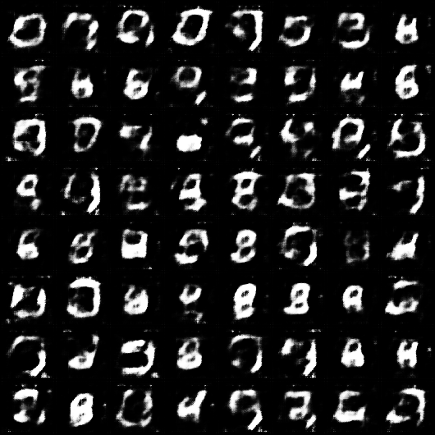
Testing and Results
No significant difference seen in 0%, 20% and 40% skew.

Slide 16
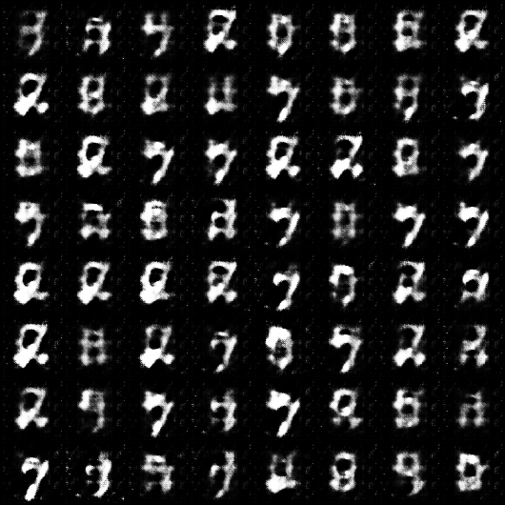
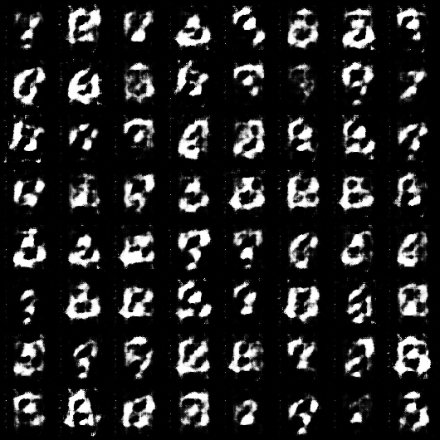
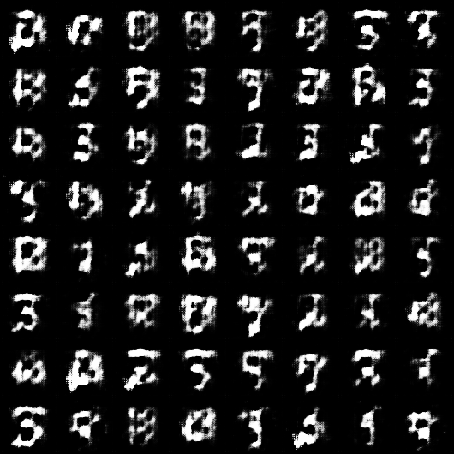
Testing and Results
At 60% and more, even the best results became harder to recognize.

Slide 17
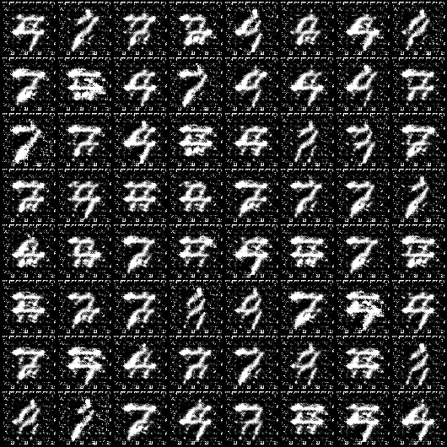
Testing and Results
Also at those percentages sometimes the generator tried generating samples that are found within all of the datasets. Basically generating in the intersection of the distributions.

Slide 18
Conclusion and Future Work
MD-GAN is definitely susceptible to different distributions of data in nodes. It becomes evident around 60% skew.
Problems include worse results and sometimes mode collapse.
I think that using GAN methods that combat mode collapse will not help. In fact, it might prevent convergence because it wants to force the generative distribution to be like the dataset distribution. This is a good avenue for further testing.

Slide 19
References
Goodfellow, Ian, et al. "Generative adversarial nets." Advances in neural information processing systems. 2014.
Li, Mu, et al. "Scaling distributed machine learning with the parameter server." 11th {USENIX} Symposium on Operating Systems Design and Implementation ({OSDI} 14). 2014.
Dean, Jeffrey, et al. "Large scale distributed deep networks." Advances in neural information processing systems. 2012.
Hardy, Corentin, Erwan Le Merrer, and Bruno Sericola. "MD-GAN: Multi-discriminator generative adversarial networks for distributed datasets." 2019 IEEE International Parallel and Distributed Processing Symposium (IPDPS). IEEE, 2019.

Slide 20
Discussion
Name two potential reasons for pursuing distributed machine learning.
What is the role of each part of a GAN network?
At what skew the results began to noticeably deteriorate? In what ways?

